Slide 1
Adidas US Sales Data Analysis
Key Insights and Visualization
Dataset: Adidas US Sales
Email: kakuturujaswith27080@gmail.com
Phone No: 9701533511

Slide 2

Introduction
This presentation summarizes the Adidas US sales data from 2020 to 2022. Using PySpark and visualization tools, we uncover key sales trends, product performance, and regional insights. The goal is to provide actionable recommendations based on data-driven findings to optimize sales strategy and profitability.

Slide 3

Dataset Description: Records and Features
The dataset includes 9,648 sales records with 13 features such as Retailer, Product, Region, Sales Method, and Profit. It captures comprehensive sales information across multiple dimensions to analyze performance and trends effectively within the US market.

Slide 4
Analytical Tools: PySpark, Pandas, Visualization Libraries
Analysis was conducted using PySpark for big data processing, complemented by Pandas for data manipulation. Visualizations created with Matplotlib and Seaborn helped reveal sales patterns, while PowerPoint was used to present insights professionally and clearly.

Slide 5
Objectives: Sales Patterns, Profitability, Regional Strengths
The primary objectives are to identify sales performance patterns, uncover profitability insights, and analyze regional strengths within the US market. This analysis aims to support strategic decisions by highlighting key sales drivers and opportunities for growth through robust data visualization techniques.

Slide 6
01
Sales & Market Insights

Slide 7
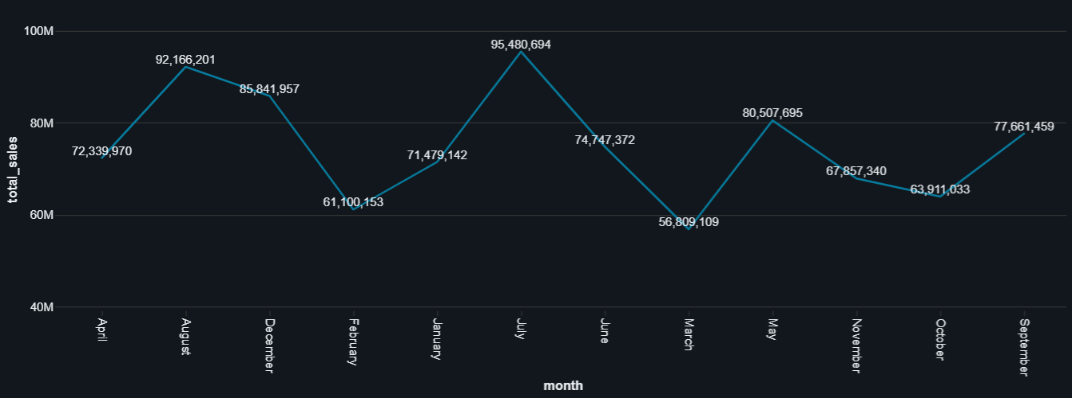
Sales Performance & Trends
Total sales reached $899.9M with unit sales of 2.48 million. The West region leads in revenue, showing consistent growth with peaks during Q2 and Q3. Seasonal trends reveal important sales cycles, providing critical timing insights for marketing and inventory planning.

Slide 8
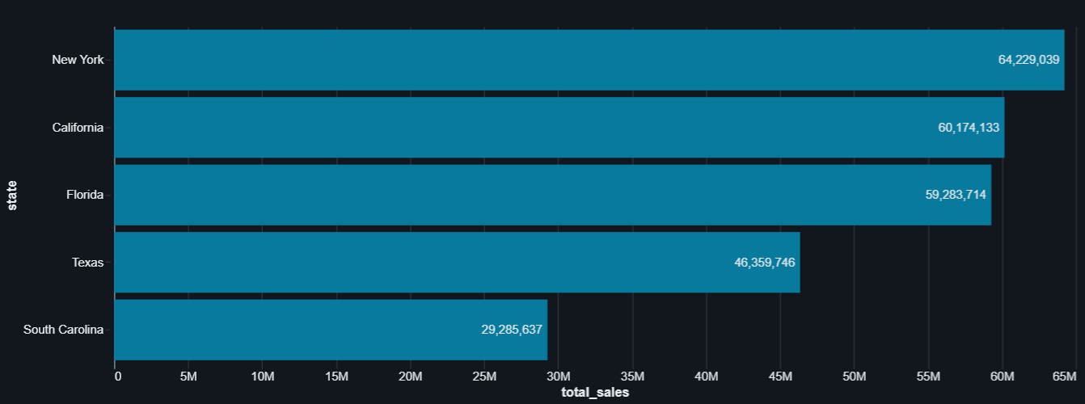
Product & Regional Analysis
Men’s Street Footwear is the top-selling product, driving overall sales dominance in the footwear category. The Western region outperforms others but opportunities exist to grow in the Midwest and South, suggesting a need for enhanced marketing and distribution strategies in these regions.

Slide 9
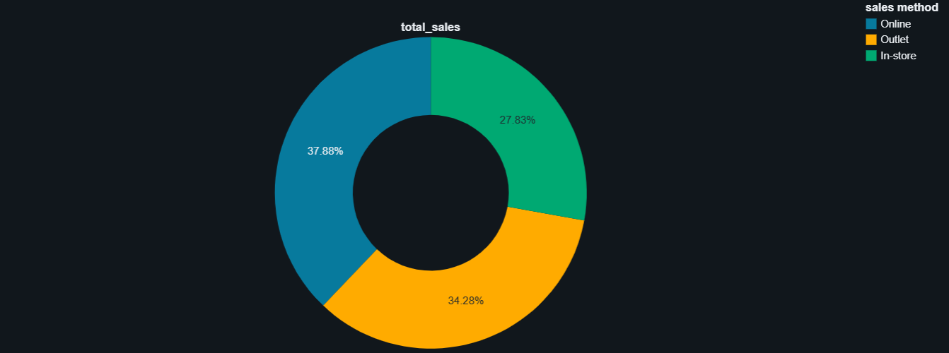
Retail Channels & Profitability Patterns
In-store sales remain the dominant channel, especially through key retailers like West Gear. Profitability focuses on high-margin footwear and the West region. There is potential to expand digital sales channels to capitalize on evolving consumer behavior and improve margin stability.

Slide 10
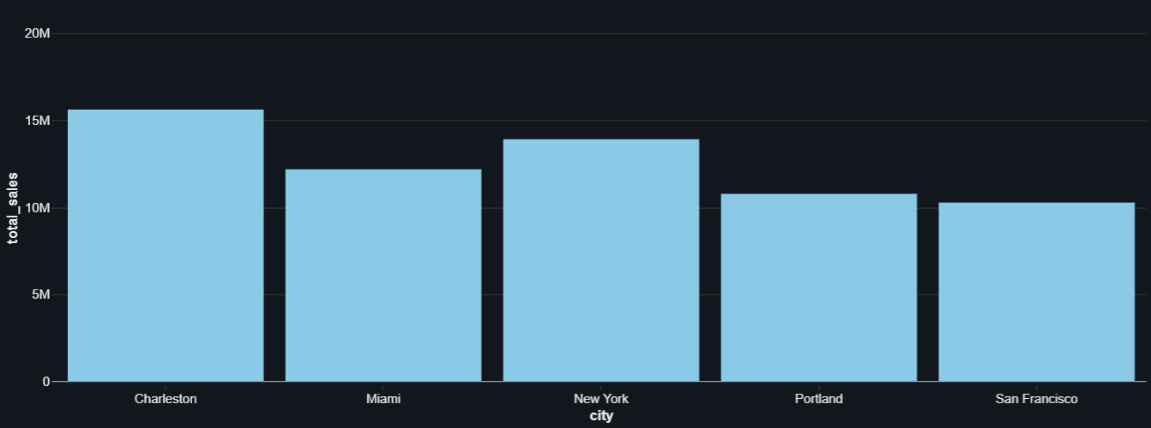
Conclusions
The Adidas US sales analysis highlights strong regional and product performance, with clear market leadership in the West and footwear segments. Strategic recommendations include expanding online channels, optimizing the product mix for profitability, and strengthening regional balance. These actionable insights will drive smarter decisions and growth opportunities moving forward.

